Slide 1
Significant Figures
PP 6a
Honors Chemistry

Slide 2
Let’s Review Measurements:
Every measurement has UNITS.
Every measurement has UNCERTAINTY.

Slide 3
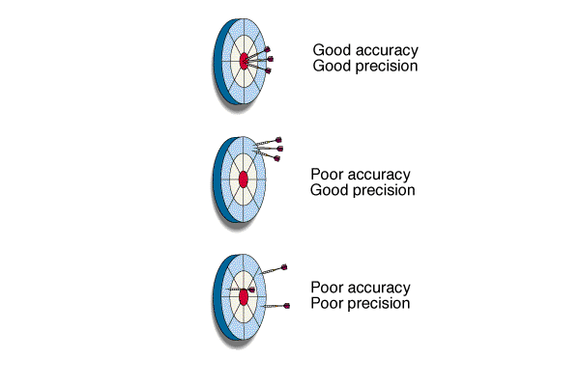
Accuracy and Precision in Measurements
Accuracy: how close a measurement is to the accepted value.
Precision: how close a series of measurements are to one another or how far out a measurement is taken.

Slide 4
Significant Figures are used to indicate the precision of a measured number or to express the precision of a calculation with measured numbers.
In any measurement
the digit farthest to the right is considered to be estimated.
0
1
2
2.0
1.3

Slide 5
When to use Significant figures
To a mathematician 21.70, or 21.700 is the same.

Slide 6
But, to a scientist 21.70cm and 21.700cm is NOT the same
21.700cm to a scientist means the measurement is accurate to within one thousandth of a cm.

Slide 7
How do I know how many Sig Figs?
Rule: Nonzero integers (1-9) always count as significant figures.
3456 has 4 sig figs (significant figures).
.

Slide 8
How many sig figs?
7
40
0.5
0.00003
7 x 10⁵
7,000,000
1
1
1
1
1
1

Slide 9
How do I know how many Sig Figs?
There are three classes of zeros.
a. Leading zeros are zeros that precede all the nonzero digits. These do not count as significant figures.
0.048 has 2 sig figs

Slide 10
How do I know how many Sig Figs?
b. Captive or sandwhiched zeros are zeros between nonzero digits. These always count as significant figures.
16.07 has 4 sig figs.

Slide 11
How do I know how many Sig Figs?
c. Trailing zeros are zeros at the right end of the number. They are significant only if the number contains a decimal point.
9.300 has 4 sig figs.
150 has 2 sig figs.

Slide 12
How do I know how many Sig Figs?
300. Contains three significant figures.
Notice the decimal made the 2 zeros significant. If the number was written as 300 without the decimal then it would only have one sig fig.
.

Slide 13
How many sig figs here?
3401
2100
2100.0
5.00
0.00412
8,000,050,000
4
2
5
3
3
6

Slide 14
How many sig figs here?
1.2
2100
56.76
4.00
0.0792
7,083,000,000
2
2
4
3
3
4

Slide 15
Exponential Notation
Rule for numbers written in exponential form. If your value is expressed in proper exponential notation, all of the figures in the pre-exponential value (prior to the x 10) are significant. “7.143 × 10⁻³ grams” contains 4 significant figures (SF)

Slide 16
What about calculations with sig figs?
Rule: When adding or subtracting measured numbers, the answer can have no more places after the decimal than the LEAST of the measured numbers.

Slide 17
Add/Subtract examples
2.45cm + 1.2cm = 3.65cm,
Round off to = 3.7cm
7.432cm + 2cm = 9.432 round to → 9cm

Slide 18
Multiplication and Division
Rule: When multiplying or dividing, the result can have no more significant figures than the least reliable measurement.

Slide 19
A couple of examples
56.78 cm x 2.45cm = 139.111 cm²
Round to → 139cm²
75.8cm x 9.6cm = ?

Slide 20
Rules for Rounding:
1. In a series of calculations carry the extra digits through to the final result, then round 2. If the digit to be removed is less than 5, the preceding digit stays the same. For example, 2.34 rounds to 2.3 3. If the digit to be removed is equal or greater than 5, then the preceding digit is increased by 1. For example, 2.36 rounds to 2.4.

Slide 21
Let’s take a “Quiz”
1. The term that is related to the reproducibility (repeatability) of a measurement is
a. accuracy.
b. precision.
c. qualitative.
d. quantitative.
e. property.
b. precision.
2. The number of significant figures in the mass measured as 0.010210 g is
a. 1.
b. 2.
c. 3.
d. 4.
e. 5.
e. 5.

Slide 22
3. The number of significant figures in 6.0700 x 10⁻⁴… is
a. 3.
b. 4.
c. 5.
d. 6.
e. 7.
c. 5.
4. How many significant figures are there in the value 0.003060?
a. 7
b. 6
c. 5
d. 4
e. 3
d. 4

